Slide 1
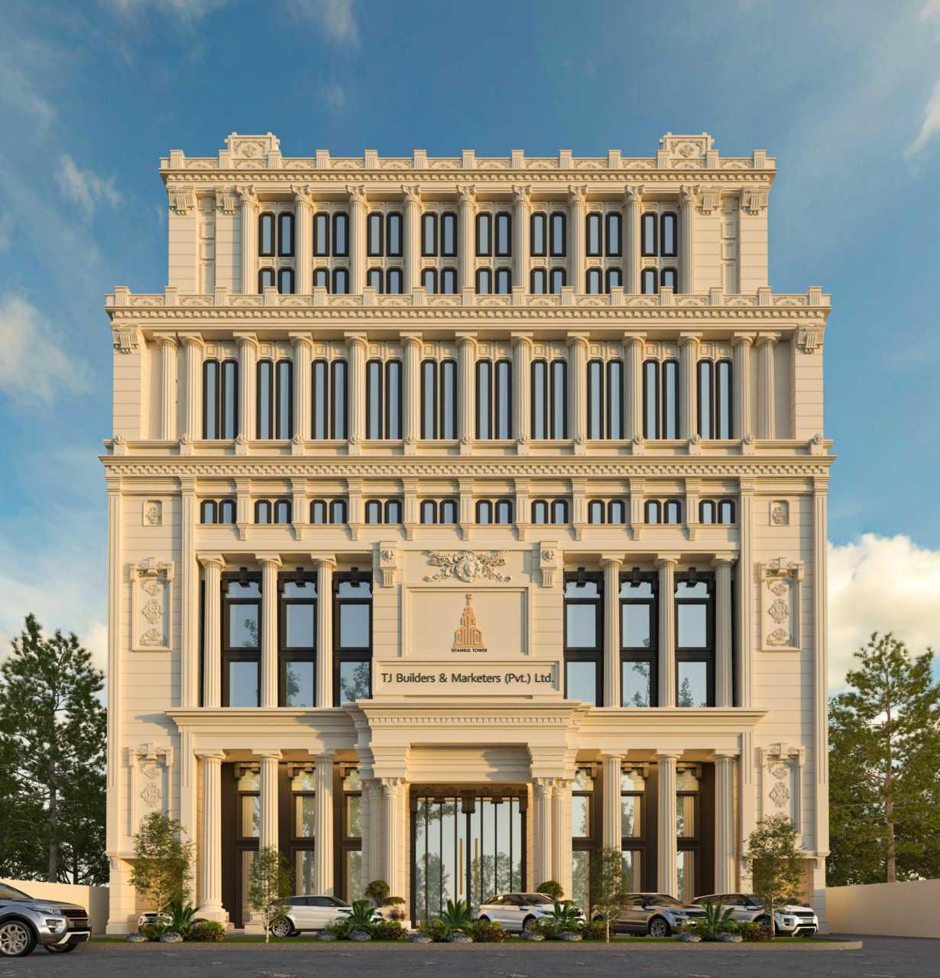

Digital Vision
M. Qaisar Ansar Kasana

Slide 2
About Me
CEO & Head of Innovation Goprogs Technologies Pvt Ltd
Double Gold Medalist
IT Analyst on National Media
Ambassador, IEEE Asia Pacific Region
Global Winner IEEE Richard E. Merwin Award
Winner of Many National Tech Competitions
NasCon, AirTech, NEO, etc

Slide 3
Let’s Begin

Slide 4

Digitally enabled environment

Slide 5
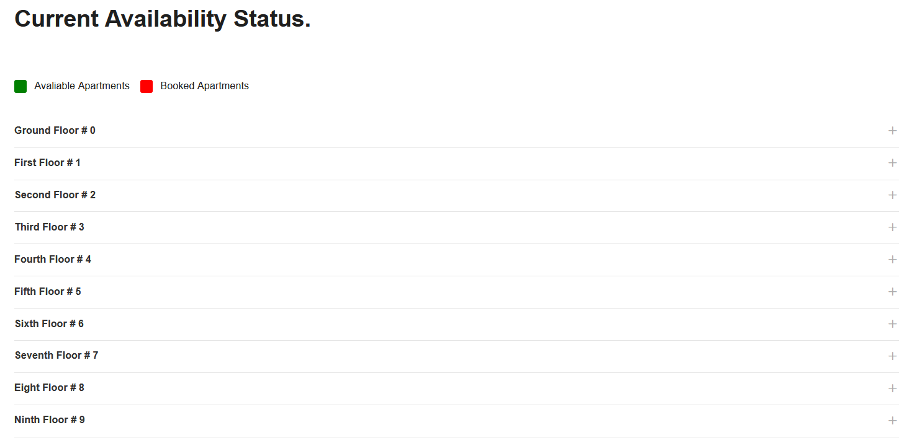
istanbultowerbwc.com/status

Slide 6
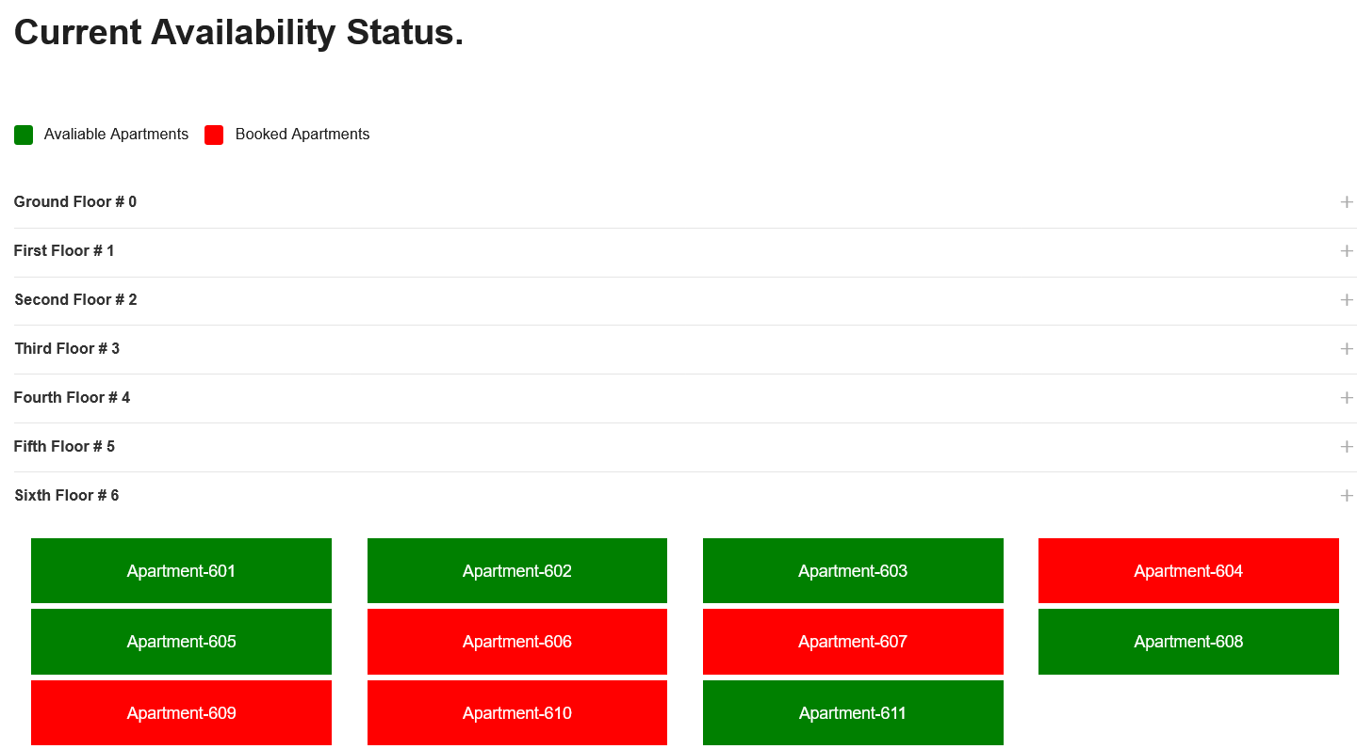
istanbultowerbwc.com/status

Slide 7
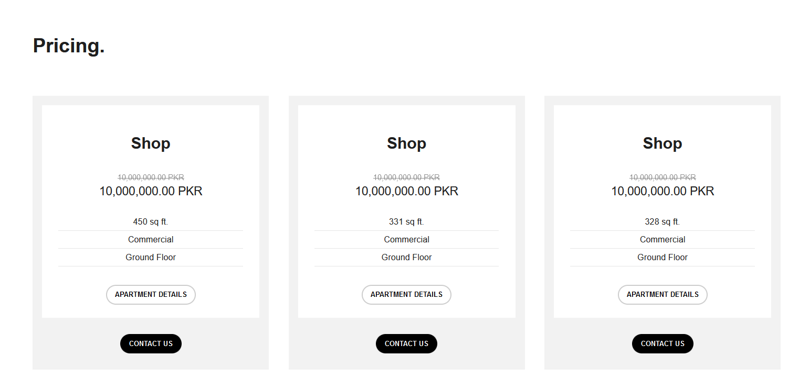
istanbultowerbwc.com/pricing

Slide 8
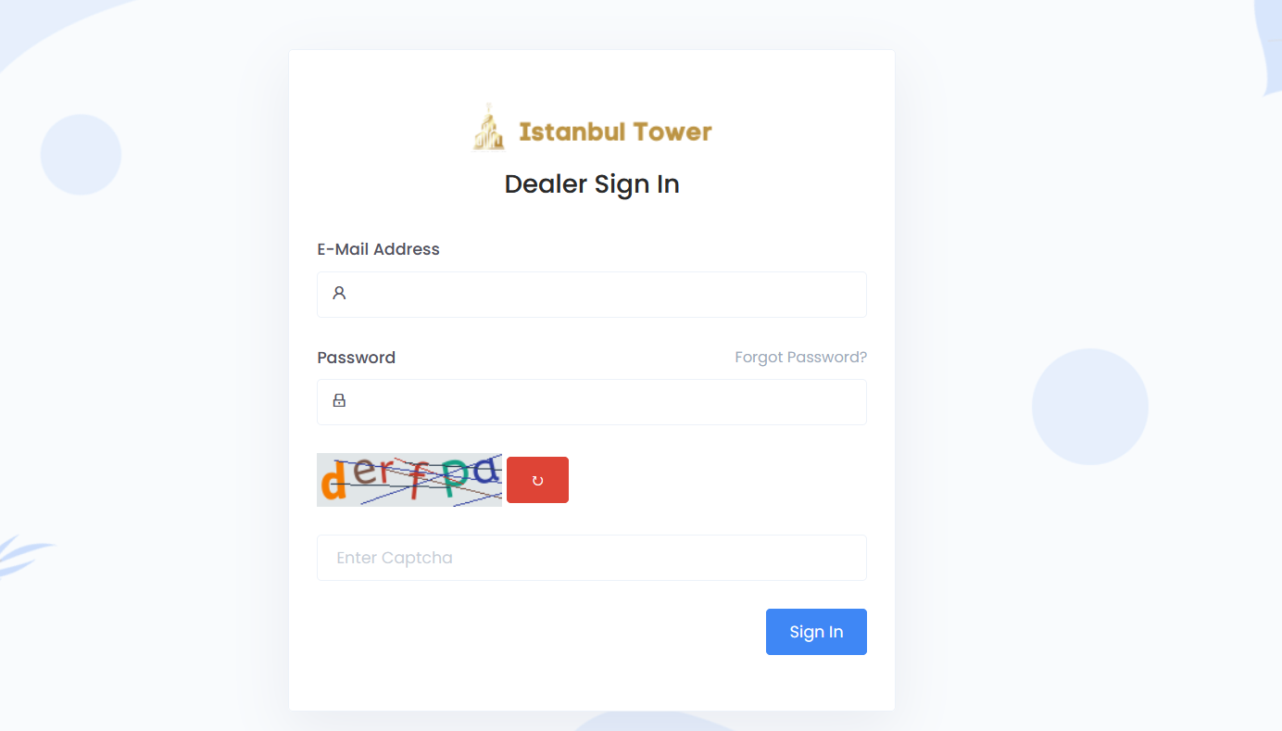
istanbultowerbwc.com/dealer/auth/login

Slide 9
Efficient
Booking
Installments Schedule
Client Mobile App
Transfer request
SMS Alerts enabled
Encryption/Security
Easy to track your bookings
One click, Done

Slide 10
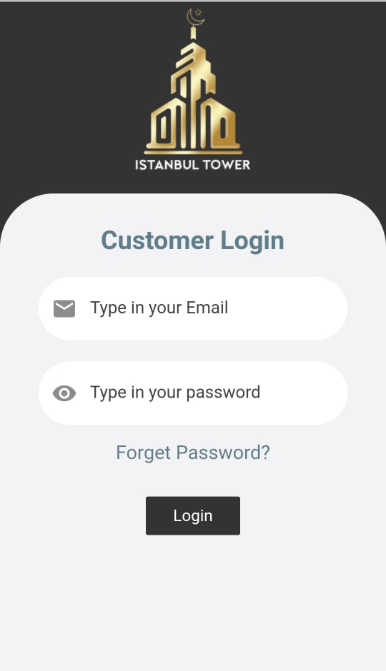
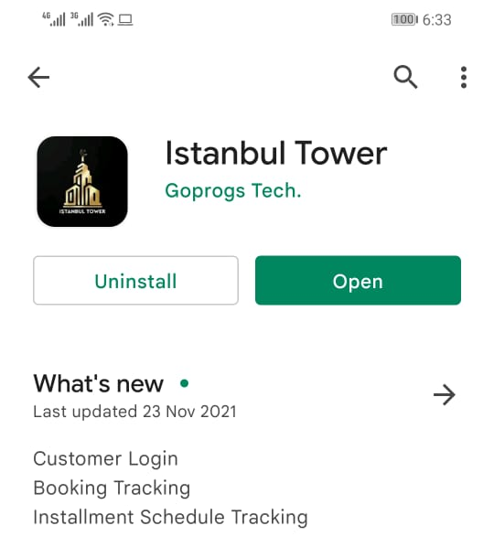
Mobile App - Google Play Store

Slide 11
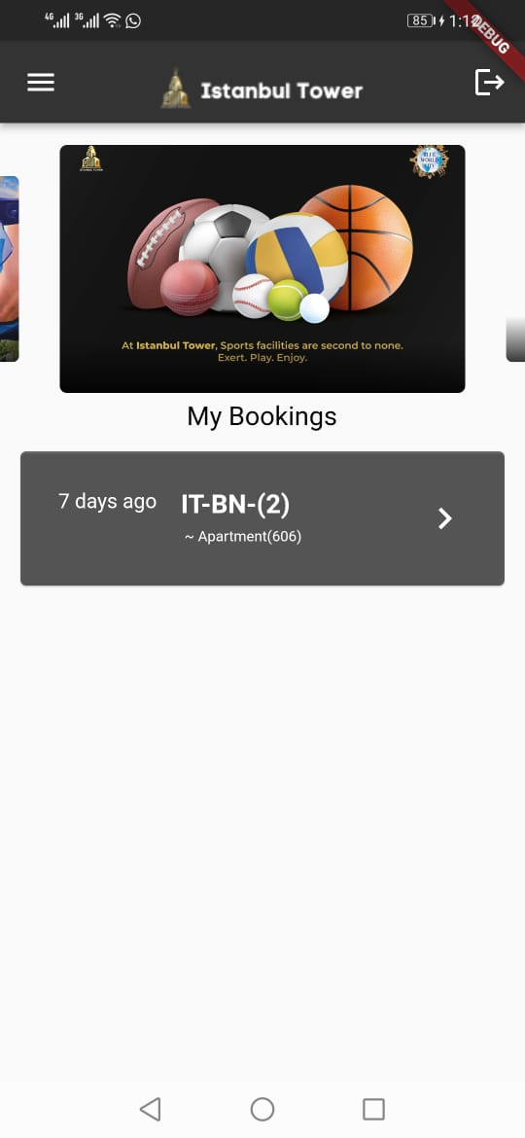
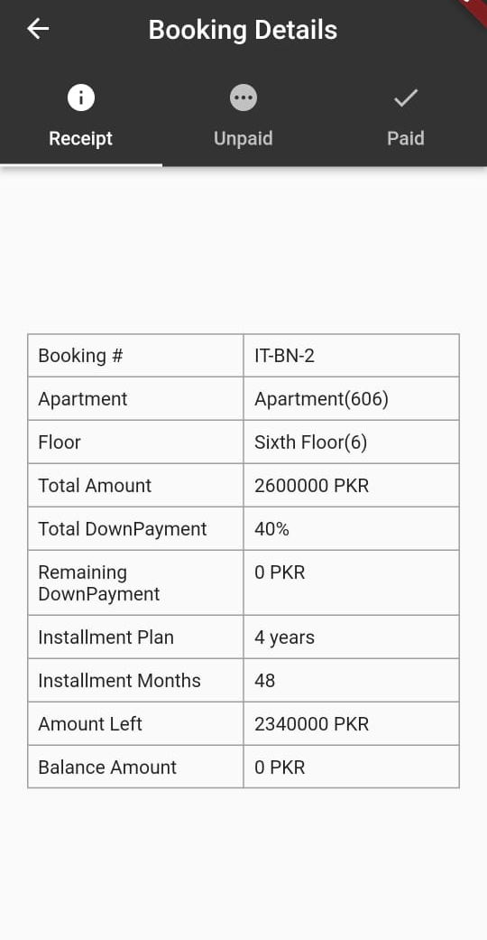
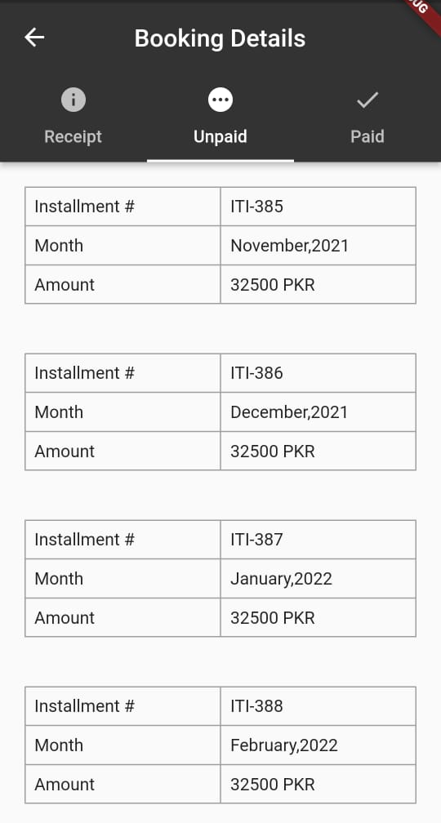
Mobile App - Google Play Store

Slide 12
What Next?
Rental Option
Apps new version
Enhanced CRM
Online transfer initiation
Better to Best

Slide 13
Feed Your Imagination.

